Slide 2
To all who are spiritually weary and seek rest; to all who are sad and long for comfort; to all who struggle and desire victory; to all who sin and need a Savior; to all who are strangers and want friendship; to all who hunger and thirst for something real and lasting; and to all who come here, this church opens wide her doors and offers welcome in the name of the Lord Jesus Christ

Slide 3
Please Silence Cell Phones At This Time

Slide 5
Christmas Prayer for Illumination: ALL: Dear Heavenly Father, Help me to hear your voice. Send Me your Holy Spirit once again. Give me the courage to be your beloved. Give me courage to choose joy. I need you now this Christmas. Be born in me again. Today. In Jesus' name, Amen.

Slide 6
WELCOME

Slide 7
Angels from the Realms of Glory Hymn # 259

Slide 8
Angels from the realms of glory, Wing your flight o’er all the earth; Ye who sang creation’s story, Now proclaim Messiah’s birth: Come and worship, come and worship, Worship Christ , the newborn King.

Slide 9
Shepherds in the fields abiding, Watching o’er your flocks by night, God with man is now residing, Yonder shines the infant Light: Come and worship, come and worship, Worship Christ , the newborn King.

Slide 10
Sages, leave your contemplations, Brighter visions beam afar; Seek the great Desire of nations, Ye have seen his natal star: Come and worship, come and worship, Worship Christ , the newborn King.

Slide 11
Saints before the altar bending, Watching long in hope and fear, Suddenly the Lord, descending, In his temple shall appear: Come and worship, come and worship, Worship Christ , the newborn King.

Slide 12
Tho’ an infant now we view Him, He will share His Father’s throne; Gather all the nations to Him; Every knee shall then bow down. Come and worship, come and worship Worship Christ the new born king

Slide 14
Lighting the Advent Candles

Slide 15
Call To Worship Donna Brown Liturgist

Slide 16
Reader: He shall feed His flock like a shepherd: He shall gather the lambs with His arm, and carry them in His bosom, and shall gently lead those that are with young. (Isaiah 40.11)

Slide 17
People: Therefore the Lord Himself shall give you a sign; Behold, a virgin shall conceive, and bear a Son, and they shall call His name Emmanuel, which being interpreted is, God with us.

Slide 19
PRAYER OF CONFESSION

Slide 20
ALL: Holy and merciful God, in your presence we confess our sinfulness, our short comings, and our offenses against you.

Slide 21
ALL: You alone know how often we have sinned in wandering from your ways, in wasting your gifts, in forgetting your love.

Slide 22
ALL: Have mercy on us, O Lord, for we are ashamed and sorry for all we have done to displease you.

Slide 23
ALL: Forgive our sins, and help us to live in your light and walk in your ways, for the sake of Jesus Christ, our Savior. Lord, hear our prayers.

Slide 25
A moment for meditation and silent confession

Slide 26
Words of Assurance and Pardon of the Gospel (from 1 John 1:5, 7) Elder Sondra Jester, Liturgist

Slide 27
Liturgist: This is the message we have heard from God and proclaim to you, that God is light and in God there is no darkness at all. If we walk in the light, as God is in the light, we have fellowship with one another, and the blood of Jesus his Son cleanses us from all sin.

Slide 29
Angels We Have Heard on High
Hymn 113

Slide 30
Angels we have heard on high,
Sweetly singing o’er the plains,
And the mountains in reply
Echo back their joyous strains.
Gloria in excelsis Deo,
Gloria in excelsis Deo.

Slide 31
Shepherds, why this jubilee?
Why your joyous strains prolong?
Say what may the tidings be,
Which inspire your heav’nly song?
Gloria in excelsis Deo,
Gloria in excelsis Deo.
verse 2 & refrain

Slide 32
Come to Bethlehem, and see
Him whose birth the angels sing;
Come, adore on bended knee
Christ the Lord, the newborn King.
Gloria in excelsis Deo,
Gloria in excelsis Deo.
verse 3 & refrain

Slide 33
See within a manger laid
Jesus, Lord of heav’n and earth!
Mary, Joseph, lend your aid,
With us sing our savior’s birth.
Gloria in excelsis Deo,
Gloria in excelsis Deo.
* verse 4 & refrain

Slide 35
Teaching Moment Pastor Dustin Advent Teaching Series

Slide 36
The Lord’s Prayer
OUR FATHER, WHO ART IN HEAVEN,
HALLOWED BE THY NAME.
THY KINGDOM COME, THY WILL BE DONE,
ON EARTH AS IT IS IN HEAVEN.
GIVE US THIS DAY OUR DAILY BREAD,
AND FORGIVE US OUR DEBTS AS WE FORGIVE OUR DEBTORS;
AND LEAD US NOT INTO TEMPTATION
BUT DELIVER US FROM EVIL.
FOR THINE IS THE KINGDOM,
AND THE POWER, AND THE GLORY FOREVER
AMEN

Slide 37
OFFERTORY

Slide 38
Offsite contributions can be made via Tithely.com the instructions are on our website bayshoregardenscommunitychurch.com or checks can be mailed to 6228 26th street west Bradenton FL 34207

Slide 39
Doxology

Slide 40
Praise God
from whom all blessings flow;
Praise Him,
all creatures here below;
Praise Him
above, ye heav’nly host;
Praise Father,
Son, and Holy Ghost.

Slide 42
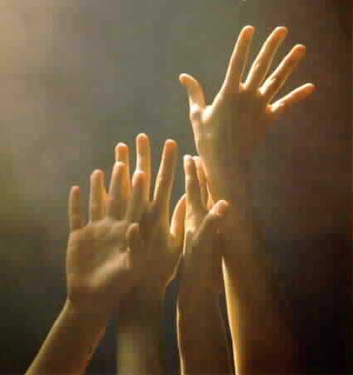
‘O COME, ALL YE FAITHFUL’
#249
[ All who are able please stand ]

Slide 43
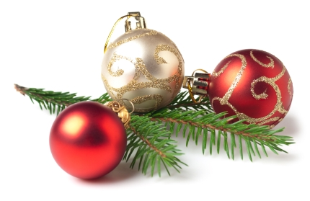
(1)
O come all ye faithful,
joyful and triumphant,
O come ye, O come ye to Bethlehem!
Come and behold Him,
born the King of angels.
O come, let us adore Him,
O come, let us adore Him,
O come, let us adore Him,
Christ, the Lord.

Slide 44
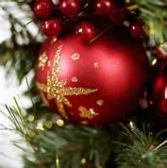
(2)
Sing, choirs of angels,
sing in exultation;
O sing all ye bright hosts of heaven above!
Glory to God,
all glory in the highest.
O come, let us adore Him,
O come, let us adore Him,
O come, let us adore Him,
Christ, the Lord.

Slide 45
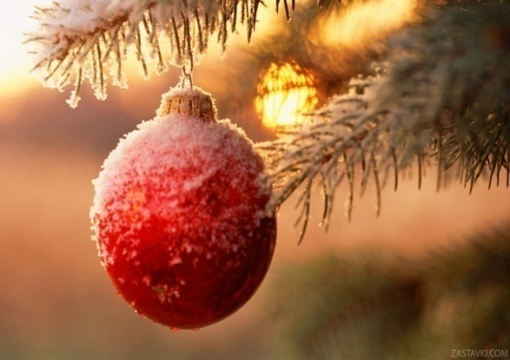
(3)
Yea, Lord, we greet Thee,
born this happy morning;
Jesus, to You be all glory given;
Word of the Father
now in flesh appearing!
O come, let us adore Him,
O come, let us adore Him,
O come, let us adore Him,
Christ, the Lord.

Slide 47
THE PASTORAL BENEDICTION
God has a plan for you and,
you are EXACTLY where God wants you to be.

