Slide 2
To all who are spiritually weary and seek rest; to all who are sad and long for comfort; to all who struggle and desire victory; to all who sin and need a Savior; to all who are strangers and want friendship; to all who hunger and thirst for something real and lasting; and to all who come here, this church opens wide her doors and offers welcome in the name of the Lord Jesus Christ

Slide 3
Please Silence Cell Phones At This Time

Slide 5
‘JOY TO THE WORLD’
#270

Slide 6
(1)
Joy to the world! The Lord is come;
Let earth receive her King.
Let every heart, prepare Him room,
And heaven and nature sing,
And heaven and nature sing,
And heaven,
and heaven and nature sing.

Slide 7
(2)
Joy to the world! The Savior reigns;
Let men their songs employ;
While fields and floods,
rocks, hills and plains,
Repeat the sounding joy,
Repeat the sounding joy,
Repeat,
Repeat the sounding joy.

Slide 8
(3)
No more let sin and sorrow grow,
Nor thorns infest the ground.
He comes to make His blessings flow
Far as the curse is found,
Far as the curse is found,
Far as,
far as the curse is found.

Slide 9
(4)
He rules the world
with truth and grace,
And makes the nations prove
The glories of His righteousness
And wonders of His love,
And wonders of His love,
And wonders,
wonders of His love.

Slide 11
WELCOME

Slide 12
Lighting the Advent Candles

Slide 13
CHOIR “Born Tonight in Bethlehem”

Slide 14
Call To Worship (Adapted from Psalm 36:5-7) Deacon David Smukala, Liturgist

Slide 15
Reader: Your love, Lord, reaches to the heavens,

Slide 16
People: Your faithfulness to the skies.

Slide 17
Reader: Your righteousness is like the highest mountains,

Slide 18
People: Your justice like the great deep.

Slide 19
Reader: You, Lord, preserve both people and animals.

Slide 20
People: How priceless is your unfailing love, O God!

Slide 21
Reader: People take refuge in the shadow of your wings.

Slide 22
People: We celebrate your incredible love today.

Slide 24
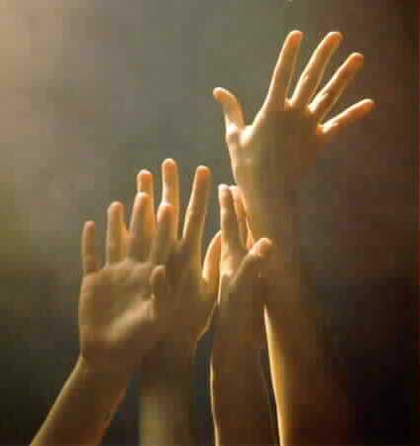
‘O COME, ALL YE FAITHFUL’
#249
[ All who are able please stand ]

Slide 25
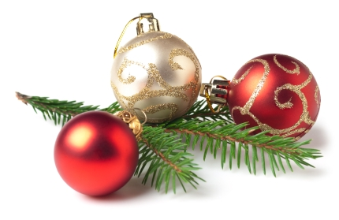
(1)
O come all ye faithful,
joyful and triumphant,
O come ye, O come ye to Bethlehem!
Come and behold Him,
born the King of angels.
O come, let us adore Him,
O come, let us adore Him,
O come, let us adore Him,
Christ, the Lord.

Slide 26
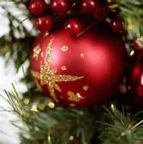
(2)
Sing, choirs of angels,
sing in exultation;
O sing all ye bright hosts of heaven above!
Glory to God,
all glory in the highest.
O come, let us adore Him,
O come, let us adore Him,
O come, let us adore Him,
Christ, the Lord.

Slide 27
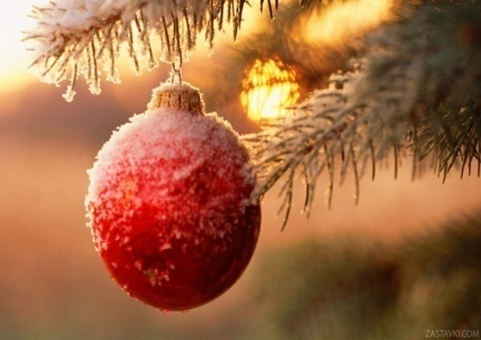
(3)
Yea, Lord, we greet Thee,
born this happy morning;
Jesus, to You be all glory given;
Word of the Father
now in flesh appearing!
O come, let us adore Him,
O come, let us adore Him,
O come, let us adore Him,
Christ, the Lord.

Slide 29
Advent Prayer

Slide 30
ALL: Lord, thank You for loving us so much that You gave Your Son for us, even before we loved You. Thank You for inviting us into Your family.

Slide 31
ALL: For all of us who are brothers and sisters in faith, please help us to love one another in perfect harmony. Father, please help us to see every person the same way that You see them.

Slide 32
ALL: Help us to love others as you do — even when they don’t love us back.

Slide 33
ALL: Please show us how to walk continually in Your love, that perfect love which casts out fear. We love you, Lord.

Slide 35
A moment for meditation and silent confession

Slide 36
Words of Assurance and Pardon of the Gospel Jeanie Smith, Liturgist

Slide 37
Liturgist: In those days and at that time I will cause a righteous Branch to spring up for David, and he shall execute justice and righteousness in the land. In those days Judah will be saved, and Jerusalem will dwell securely. And this is the name by which it will be called: ‘The LORD is our righteousness.’(Jeremiah 33.15-16)

Slide 39
O Little Town Of Bethlehem
Hymn 121

Slide 40
O little town of Bethlehem, How still we see thee lie! Above thy deep and dreamless sleep the silent stars go by. Yet in thy dark streets shineth The everlasting light The hopes and fears of all the years Are met in thee tonight

Slide 41
It Came Upon A Midnight Clear

Slide 42
1. It came upon a midnight clear,
That glorious song of old,
From angels bending near the earth to touch their harps of gold:
“Peace on the earth, goodwill to men
From heav’n’s all-gracious King”
The world in solemn stillness lay
To hear the angels sing.

Slide 44
Teaching Moment Pastor Dustin “All You Need is Love”

Slide 45
The Lord’s Prayer
OUR FATHER, WHO ART IN HEAVEN,
HALLOWED BE THY NAME.
THY KINGDOM COME, THY WILL BE DONE,
ON EARTH AS IT IS IN HEAVEN.
GIVE US THIS DAY OUR DAILY BREAD,
AND FORGIVE US OUR DEBTS AS WE FORGIVE OUR DEBTORS;
AND LEAD US NOT INTO TEMPTATION
BUT DELIVER US FROM EVIL.
FOR THINE IS THE KINGDOM,
AND THE POWER, AND THE GLORY FOREVER
AMEN

Slide 46
OFFERTORY

Slide 47
Offsite contributions can be made via Tithely.com the instructions are on our website bayshoregardenscommunitychurch.com or checks can be mailed to 6228 26th street west Bradenton FL 34207

Slide 48
Doxology

Slide 49
Praise God
from whom all blessings flow;
Praise Him,
all creatures here below;
Praise Him
above, ye heav’nly host;
Praise Father,
Son, and Holy Ghost.

Slide 51
God Rest Ye Merry Gentlemen / We Three Kings

Slide 52
God rest ye merry gentlemen, Let nothing you dismay Remember Christ our savior Was born upon Christmas day To save us all from Satan's power When we were gone astray

Slide 53
Oh tidings of comfort and joy, Comfort and joy, Oh tidings of comfort and joy.

Slide 54
From God our heavenly father This blessed angel came And unto certain shepherds Brought tidings of the same How that in Bethlehem was born The son of God by name

Slide 55
Oh tidings of comfort and joy, Comfort and joy, Oh tidings of comfort and joy.

Slide 56
O, Star of wonder, star of night, Star with royal beauty bright Westward leading, still proceeding, Guide us to thy perfect light.

Slide 57
Born a king on Bethlehem's plain, Gold I bring to crown him again King forever, ceasing never, Over us all to reign.

Slide 58
O, Star of wonder, star of night, Star with royal beauty bright Westward leading, still proceeding, Guide us to thy perfect light.

Slide 59
Glorious now, behold Him arise. King and God and sacrifice Hallelujah, Hallelujah! Worship him God most high

Slide 60
O, Star of wonder, star of night, Star with royal beauty bright Westward leading, still proceeding, Guide us to thy perfect light.

Slide 61
God rest ye merry gentlemen, let nothing you dismay.

Slide 63
THE PASTORAL BENEDICTION
God has a plan for you and,
you are EXACTLY where God wants you to be.

Slide 64
2023 as of the end of November. Total Income - $273,762.09 Total Expenses - $274,847.87 Balance – (-) $1,085.78 Budget for 2024 Total Income - $364,416.15 Total Expenses - $347,360.15 Balance - $17,056.00

