Slide 2
To all who are spiritually weary and seek rest; to all who are sad and long for comfort; to all who struggle and desire victory; to all who sin and need a Savior; to all who are strangers and want friendship; to all who hunger and thirst for something real and lasting; and to all who come here, this church opens wide her doors and offers welcome in the name of the Lord Jesus Christ

Slide 3
Please Silence Cell Phones At This Time

Slide 5
O Come, O come Emmanuel

Slide 6
O come, O come Emmanuel, And ransom captive Israel That mourns in lowly exile here, Until the son of God appear.

Slide 7
Rejoice! Rejoice! Emmanuel shall come to you, O Israel.

Slide 8
O come, Thou Dayspring, come and cheer Our spirits by Thine advent here; Disperse the gloomy clouds of night, And death’s dark shadows put to flight.

Slide 9
Rejoice! Rejoice! Emmanuel shall come to you, O Israel.

Slide 10
O come, Thou Wisdom from on high And order all things far and nigh; To us the path of knowledge show and cause us in her ways to go.

Slide 11
Rejoice! Rejoice! Emmanuel shall come to you, O Israel.

Slide 12
O come, Desire of nations, bind All peoples in one heart and mind; Bid envy, strife and quarrels cease; Fill the whole world with heaven’s peace.

Slide 13
Rejoice! Rejoice! Emmanuel shall come to you, O Israel.

Slide 14
WELCOME

Slide 15
Lighting the Advent Candles

Slide 16
Call To Worship Elder Roy Palk, Liturgist

Slide 17
Reader: Comfort, comfort My people, says your God. Speak tenderly to Jerusalem, and cry to her that her warfare is ended, that her iniquity is pardoned, that she has received from the LORD’s hand double for all her sins.

Slide 18
People: A voice cries: “In the wilderness prepare the way of the LORD; make straight in the desert a highway for our God.

Slide 19
Reader: Every valley shall be lifted up, and every mountain and hill be made low;

Slide 20
People: The uneven ground shall become level, and the rough places a plain.”

Slide 22
Come,Thou Long Expected Jesus
Hymn 244

Slide 23
Come, Thou long expected Jesus,
Born to set Thy people free;
From our fears and sins release us;
Let us find our rest in Thee.
Israel’s strength and consolation;
Hope of all the earth Thou art;
Dear Desire of every nation,
Joy of every longing heart.

Slide 24
Born Thy people to deliver,
Born a child and yet a king.
Born to reign in us forever,
Now Thy gracious kingdom bring.
By Thine own eternal Spirit
Rule in all our hearts alone;
By Thine all sufficient merit,
Raise us to Thy glorious throne.
*

Slide 26
PRAYER OF CONFESSION

Slide 27
ALL: O Lord Christ, we confess our willingness to be loved but also our reluctance to love others.

Slide 28
ALL: We confess our readiness to accept Your forgiving love, but also our refusal to forgive others.

Slide 29
ALL: We confess our eagerness to grasp Your offer of redeeming love, but also our resistance to follow You without question.

Slide 30
ALL: In this Advent time, forgive us our failure to act and live as we should. Come to us anew, and by Your grace, assist us to receive You with joy,

Slide 31
ALL: as the shepherds; with gratitude, as Simeon; with obedience, as Mary; with love, as You have loved us.

Slide 32
ALL: Even so: come, Lord Jesus. Lord, hear our prayers.

Slide 34
A moment for meditation and silent confession

Slide 35
Words of Assurance and Pardon of the Gospel (Isaiah 9.2) Jeanie Smith, Liturgist

Slide 36
Liturgist: The people who walked in darkness have seen a great light; those who dwelt in a land of deep darkness, on them has light shone.

Slide 38
The Solid Rock Hymn # 526

Slide 39
My hope is built on nothing less Than Jesus’ blood and righteousness; I dare not trust the sweetest frame, But wholly lean on Jesus’ name. On Christ the solid Rock I stand; All other ground is sinking sand, All other ground is sinking sand.

Slide 40
When darkness veils His lovely face, I rest on His unchanging grace; In every high and stormy gale, My anchor holds within the veil. On Christ the solid Rock I stand; All other ground is sinking sand, All other ground is sinking sand.

Slide 41
His oath, His covenant, His blood Support me in the whelming flood; When all around my soul gives way He then is all my hope and stay. On Christ the solid Rock I stand; All other ground is sinking sand, All other ground is sinking sand.

Slide 42
When He shall come with trumpet sound, O may I then in Him be found; Dressed in His righteousness alone, Faultless to stand before the throne On Christ the solid Rock I stand; All other ground is sinking sand, All other ground is sinking sand.

Slide 44
Teaching Moment “It’s (Almost) Here.” Pastor Dustin Advent Teaching Series, week 1

Slide 45
The Lord’s Prayer
OUR FATHER, WHO ART IN HEAVEN,
HALLOWED BE THY NAME.
THY KINGDOM COME, THY WILL BE DONE,
ON EARTH AS IT IS IN HEAVEN.
GIVE US THIS DAY OUR DAILY BREAD,
AND FORGIVE US OUR DEBTS AS WE FORGIVE OUR DEBTORS;
AND LEAD US NOT INTO TEMPTATION
BUT DELIVER US FROM EVIL.
FOR THINE IS THE KINGDOM,
AND THE POWER, AND THE GLORY FOREVER
AMEN

Slide 46
OFFERTORY

Slide 47
Offsite contributions can be made via Tithely.com the instructions are on our website bayshoregardenscommunitychurch.com or checks can be mailed to 6228 26th street west Bradenton FL 34207

Slide 48
Holy Communion

Slide 49
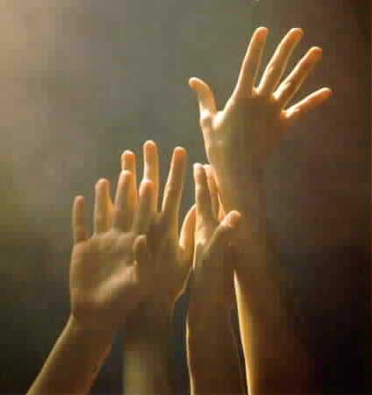
‘O COME, ALL YE FAITHFUL’
#249
[ All who are able please stand ]

Slide 50
(1)
O come all ye faithful,
joyful and triumphant,
O come ye, O come ye to Bethlehem!
Come and behold Him,
born the King of angels.
O come, let us adore Him,
O come, let us adore Him,
O come, let us adore Him,
Christ, the Lord.

Slide 51
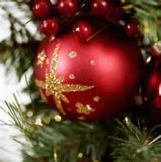
(2)
Sing, choirs of angels,
sing in exultation;
O sing all ye bright hosts of heaven above!
Glory to God,
all glory in the highest.
O come, let us adore Him,
O come, let us adore Him,
O come, let us adore Him,
Christ, the Lord.

Slide 52
(3)
Yea, Lord, we greet Thee,
born this happy morning;
Jesus, to You be all glory given;
Word of the Father
now in flesh appearing!
O come, let us adore Him,
O come, let us adore Him,
O come, let us adore Him,
Christ, the Lord.

Slide 54
THE PASTORAL BENEDICTION
God has a plan for you and,
you are EXACTLY where God wants you to be.

Slide 55
Blest Be The Tie That Binds
Hymn 426

Slide 56
Blest be the tie that binds our hearts in Christian love;
The fellowship of kindred minds is like to that above;

Slide 57
Before our Father’s throne we pour our ardent prayers;
Our fears, our hopes, our aims are one, our comforts and our cares

Slide 58
When we asunder part, it gives us inward pain;
But we shall be joined in heart, and hope to meet again.
*

