Slide 1


Slide 2
To all who are spiritually weary and seek rest; to all who are sad and long for comfort; to all who struggle and desire victory; to all who sin and need a Savior; to all who are strangers and want friendship; to all who hunger and thirst for something real and lasting; and to all who come here, this church opens wide her doors and offers welcome in the name of the Lord Jesus Christ

Slide 3

Please Silence Cell Phones At This Time

Slide 5
What a Friend We Have in Jesus
Hymn 630

Slide 6
What a friend we have in Jesus,
All our sins and griefs to bear!
What a privilege to carry
Everything to God in prayer!
O what peace we often forfeit,
O what needless pain we bear,
All because we do not carry
Everything to God in prayer!

Slide 7
Have we trials and temptations?
Is there trouble anywhere?
We should never be discouraged,
Take it to the Lord in prayer.
Can we find a friend so faithful
Who will all our sorrows share?
Jesus knows our every weakness,
Take it to the Lord in prayer.

Slide 8
Are we weak and heavy laden,
Cumbered with a load of care?
Precious Savior, still our refuge -
Take it to the Lord in prayer.
Do thy friends despise, forsake thee?
Take it to the Lord in prayer;
In His arms He’ll take and shield thee,
Thou wilt find a solace there.

Slide 10
WELCOME

Slide 11
Call To
Worship
Deacon David Smukala, Liturgist

Slide 12
Reader:
This is the day that you have made, Lord.

Slide 13
People:
Help us to rejoice in it and be glad!

Slide 14
Reader:
Remind us of the privileges we enjoy as your people:

Slide 15
People: to come to you in these moments, to confess our sins, to receive forgiveness and give it, to pray and sing and listen, to renew our fainting spirits, to rest in all your promises.

Slide 16
Reader:
Open our eyes to see you, Lord. Open our ears to hear your Word.

Slide 17
People:
Visit us through your Holy Spirit, and help us to celebrate our faith.
Amen.

Slide 19
Prayer of Confession

Slide 20
ALL:
Be mindful of your mercy, O LORD, and of your steadfast love, for they have been from of old.

Slide 21
ALL:
Do not remember the sins of my youth or my transgressions; according to your steadfast love remember me, for your goodness’ sake, O LORD!

Slide 22
ALL:
Good and upright is the LORD; therefore he instructs sinners in the way. For your name’s sake, O LORD, pardon my guilt, for it is great.

Slide 23
ALL:
Turn to me and be gracious to me, for I am lonely and afflicted. Relieve the troubles of my heart, and bring me out of my distress.

Slide 24
ALL:
Consider my affliction and my trouble, and forgive all my sins…
Lord, hear our prayers.

Slide 25
A moment for meditation and silent confession

Slide 26
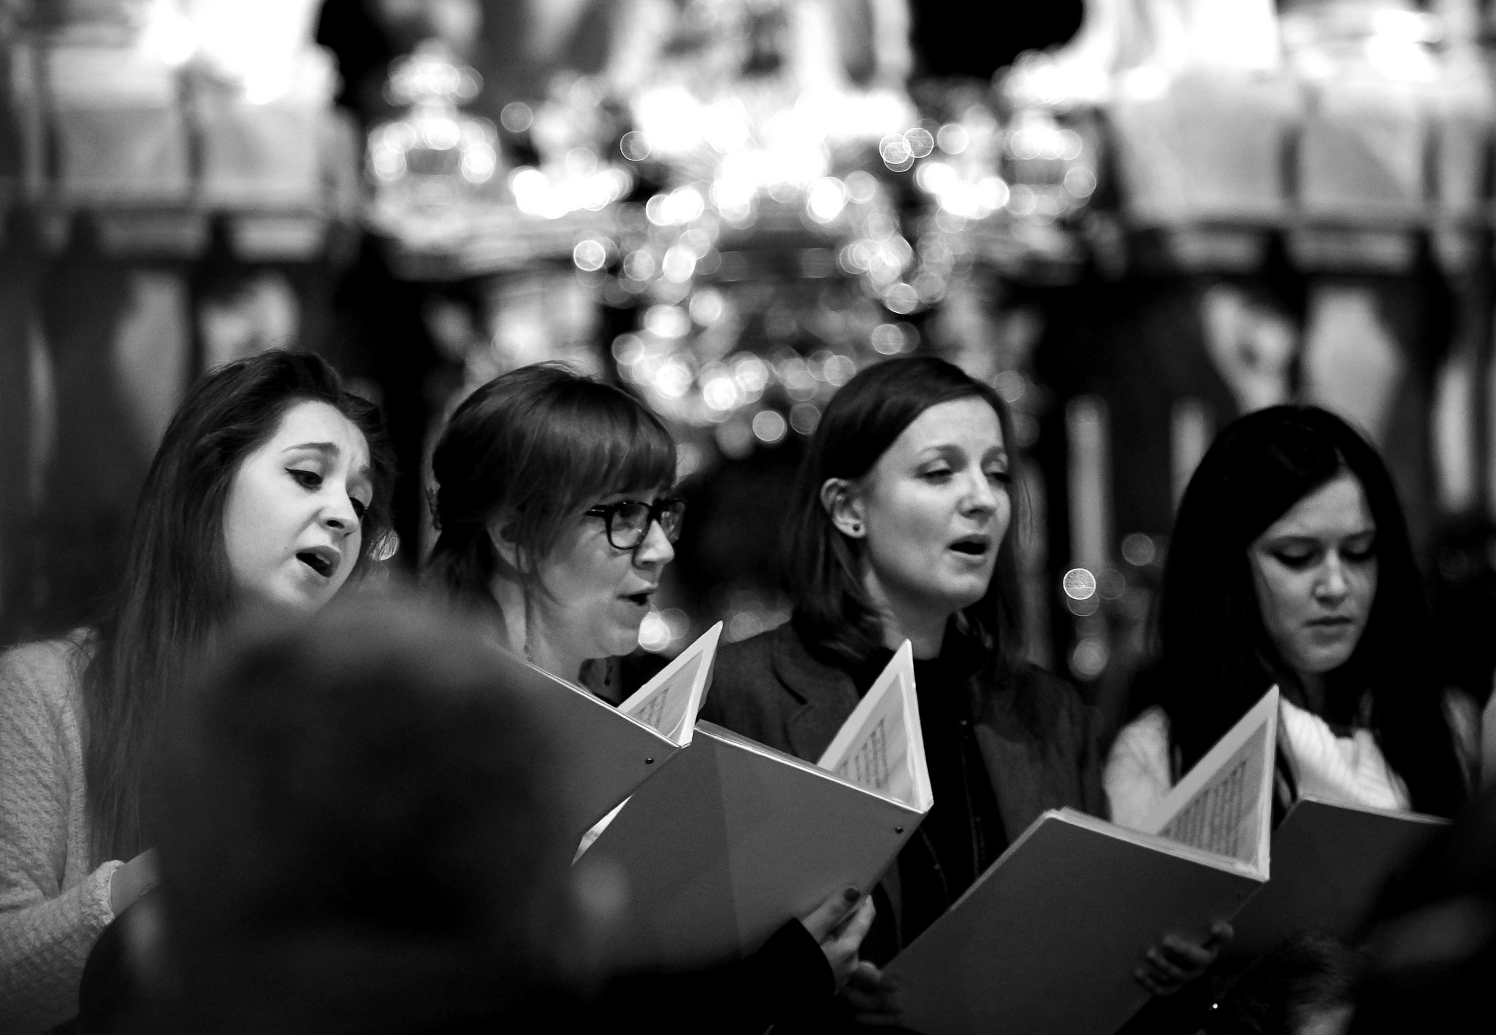
CHOIR
“O Holy Night”

Slide 27
Words of Assurance and Pardon of the Gospel
Elder Roy Palk, Liturgist

Slide 28
Liturgist:
The LORD is merciful and gracious, slow to anger and abounding in steadfast love.
As a father has compassion for his children, so the LORD has compassion for those who fear him.

Slide 29
Liturgist:
For he knows how we were made; he remembers that we are dust.
But the steadfast love of the LORD is from everlasting to everlasting on those who fear him,

Slide 30
Liturgist: and his righteousness to children’s children, to those who keep his covenant and remember to do his commandments. —

Slide 32
How Great Thou Art

Slide 33
O Lord my God, when I in awesome wonder
Consider all the worlds
Thy hands have made,
I see the stars,
I hear the rolling thunder,
Thy pow’r thro’out the universe displayed

Slide 34
Then sings my soul, my Savior God, to Thee;
How great Thou art, how great Thou art!
Then sings my soul, my Savior God to Thee:
How great Thou art, how great Thou art!

Slide 35
When thro’ the woods and forest glades I wander
And hear the birds sing sweetly in the trees,
When I look down from lofty mountain grandeur,
And hear the brook and feel the gentle breeze.

Slide 36
Then sings my soul, my Savior God, to Thee;
How great Thou art, how great Thou art!
Then sings my soul, my Savior God to Thee:
How great Thou art, how great Thou art!

Slide 37
And when I think that God,
His Son not sparing,
Sent Him to die,
I scarce can take it in,
That on the cross, my burden gladly bearing,
He bled and died to take away my sin.

Slide 38
Then sings my soul, my Savior God, to Thee;
How great Thou art, how great Thou art!
Then sings my soul, my Savior God to Thee:
How great Thou art, how great Thou art!

Slide 39
When Christ shall come with shout of acclamation
And take me home, what joy shall fill my heart!
Then I shall bow in humble adoration,
And there proclaim, my God, how great Thou art.

Slide 40
Then sings my soul, my Savior God, to Thee;
How great Thou art, how great Thou art!
Then sings my soul, my Savior God to Thee:
How great Thou art, how great Thou art!

Slide 42
Teaching Moment
“Brighter. Deeper.”
Pastor Dustin
“Sermon on the Mount”

Slide 43


Slide 44
The Lord’s Prayer
OUR FATHER, WHO ART IN HEAVEN,
HALLOWED BE THY NAME.
THY KINGDOM COME, THY WILL BE DONE,
ON EARTH AS IT IS IN HEAVEN.
GIVE US THIS DAY OUR DAILY BREAD,
AND FORGIVE US OUR DEBTS AS WE FORGIVE OUR DEBTORS;
AND LEAD US NOT INTO TEMPTATION
BUT DELIVER US FROM EVIL.
FOR THINE IS THE KINGDOM,
AND THE POWER, AND THE GLORY FOREVER
AMEN

Slide 45
OFFERTORY

Slide 46
Offsite contributions can be made via Tithely.com the instructions are on our website bayshoregardenscommunitychurch.com or checks can be mailed to
6228 26th street west
Bradenton FL 34207

Slide 47
“Softly and Tenderly”
Ken Gallo

Slide 48
Doxology

Slide 49
Praise God
from whom all blessings flow;
Praise Him,
all creatures here below;
Praise Him
above, ye heav’nly host;
Praise Father,
Son, and Holy Ghost.

Slide 51
Standing on the Promises
Hymn 410

Slide 52
Standing on the promises of Christ my King, Thro’ eternal ages let His Praises ring Glory in the highest, I will shout and sing, Standing on the promises of God

Slide 53
Standing, Standing, standing on the promises of God my savior, Standing, Standing, I’m standing on the promises of God

Slide 54
Standing on the promises that can not fail, when the howling storms of doubt and fear assail, by the living Word of God I shall prevail, standing on the promises of God

Slide 55
Standing, Standing, standing on the promises of God my savior, Standing, Standing, I’m standing on the promises of God

Slide 56
Standing on the promises,
I now can see
Perfect, present cleansing in the blood for me,
Standing in the liberty where Christ makes free,
Standing on the promises of God.

Slide 57
Standing, Standing, standing on the promises of God my savior, Standing, Standing, I’m standing on the promises of God

Slide 58
Standing on the promises of Christ the Lord, bound to Him eternally by love’s strong cord. Over coming daily with the spirit’s sword, standing on the promises of God

Slide 59
Standing, Standing, standing on the promises of God my savior, Standing, Standing, I’m standing on the promises of God

Slide 60
Standing on the promises I cannot fail, listening every moment to the Spirit’s call, resting in my Savior as my all in all,
Standing on the promises of God

Slide 61
Standing, Standing, standing on the promises of God my savior, Standing, Standing, I’m standing on the promises of God

Slide 63

THE PASTORAL BENEDICTION
God has a plan for you and,
you are EXACTLY where God wants you to be.

