Slide 1


Slide 2
To all who are spiritually weary and seek rest; to all who are sad and long for comfort; to all who struggle and desire victory; to all who sin and need a Savior; to all who are strangers and want friendship; to all who hunger and thirst for something real and lasting; and to all who come here, this church opens wide her doors and offers welcome in the name of the Lord Jesus Christ

Slide 3

Please Silence Cell Phones At This Time

Slide 5
Amazing Grace
(My Chains Are Gone)
Chris Tomlin

Slide 6
Amazing grace
How sweet the sound
That saved a wretch like me
I once was lost, but now I'm found
Was blind, but now I see

Slide 7
'Twas grace that taught my heart to fear
And grace my fears relieved
How precious did that grace appear
The hour I first believed

Slide 8
My chains are gone
I've been set free
My God, my Savior has ransomed me
And like a flood His mercy reigns
Unending love, amazing grace

Slide 9
The Lord has promised good to me
His word my hope secures
He will my shield and portion be
As long as life endures

Slide 10
My chains are gone
I've been set free
My God, my Savior has ransomed me
And like a flood His mercy reigns
Unending love, amazing grace

Slide 11
The earth shall soon dissolve like snow
The sun forbear to shine
But God, Who called me here below,
Will be forever mine.
Will be forever mine.
You are forever mine.

Slide 12
My chains are gone
I've been set free
My God, my Savior has ransomed me
And like a flood His mercy reigns
Unending love, amazing grace

Slide 14
WELCOME

Slide 15
Call To
Worship
( from Psalm 136:1-6)
Caden Grace, Liturgist

Slide 16
Reader:
Give thanks to the LORD, for he is good,

Slide 17
People: for his steadfast love endures forever.

Slide 18
Reader:
Give thanks to the God of gods,

Slide 19
People: for his steadfast love endures forever.

Slide 20
Reader:
Give thanks to the Lord of lords,

Slide 21
People: for his steadfast love endures forever.

Slide 23
SCOUT SUNDAY

Slide 24
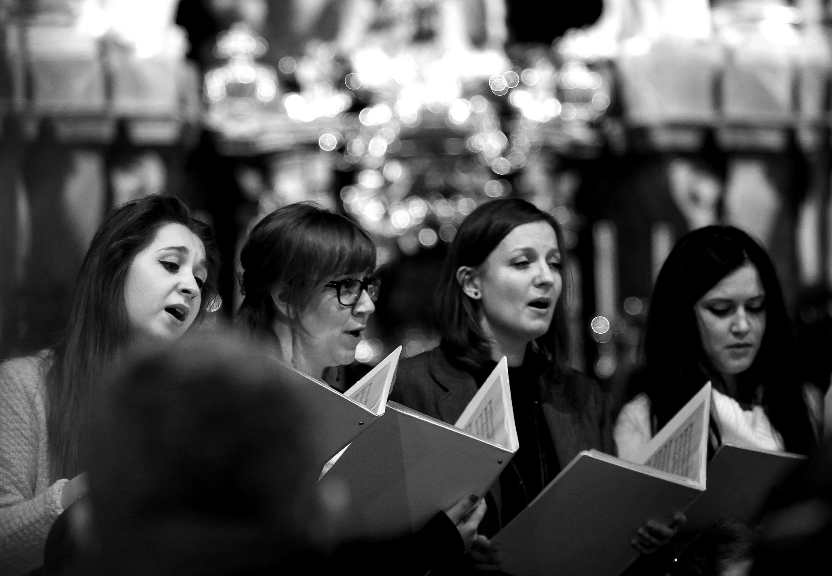
CHOIR
“Heavenly Sunlight”

Slide 25
Opening prayer

Slide 26
ALL:
God of grace, you have given us minds to know you, hearts to love you, and voices to sing your praise.

Slide 27
ALL:
Fill us with your Spirit, that we may celebrate your goodness, and worship you as best as we can, through Jesus Christ, our Lord. Amen.

Slide 28
Because He Lives
Hymn # 358

Slide 29
God sent His Son- they called Him Jesus
He came to love heal and forgive
He lived and died to buy my pardon;
An empty grave is there to prove my Savior lives

Slide 30
Because He lives
I can face tomorrow
Because He lives
All fear is gone
Because I know
He holds the future
And life is worth the living just because He Lives

Slide 31
How sweet to hold
A new-born baby and feel the pride and joy He gives
But greater still the calm assurance
This child can face uncertain days because He lives

Slide 32
Because He lives
I can face tomorrow
Because He lives
All fear is gone
Because I know
He holds the future
And life is worth the living just because He Lives

Slide 33
And then one day
I’ll cross the river;
I’ll fight life’s final war with pain and then as death gives way to vict’ry
I’ll see the lights of glory and I’ll know He reigns

Slide 34
Because He lives
I can face tomorrow
Because He lives
All fear is gone
Because I know
He holds the future
And life is worth the living just because He Lives

Slide 36
Teaching Moment
Pastor Dustin
“Sermon on the Mount”

Slide 37


Slide 38


Slide 39
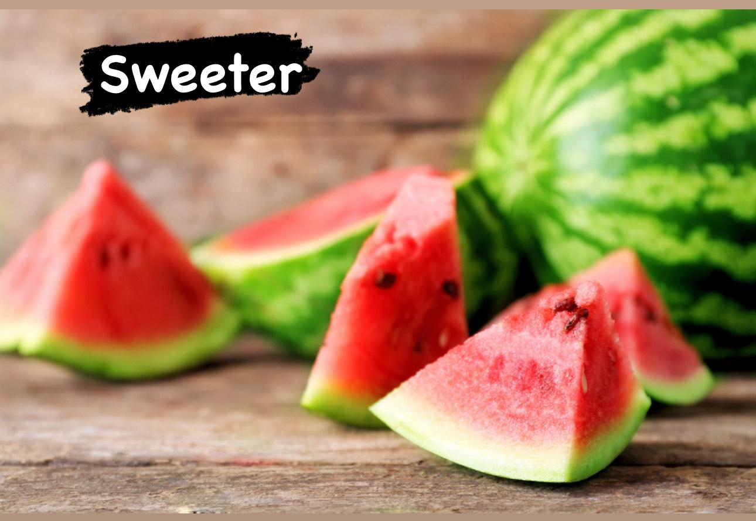

Slide 40
The Lord’s Prayer
OUR FATHER, WHO ART IN HEAVEN,
HALLOWED BE THY NAME.
THY KINGDOM COME, THY WILL BE DONE,
ON EARTH AS IT IS IN HEAVEN.
GIVE US THIS DAY OUR DAILY BREAD,
AND FORGIVE US OUR DEBTS AS WE FORGIVE OUR DEBTORS;
AND LEAD US NOT INTO TEMPTATION
BUT DELIVER US FROM EVIL.
FOR THINE IS THE KINGDOM,
AND THE POWER, AND THE GLORY FOREVER
AMEN

Slide 41
OFFERTORY

Slide 42
Offsite contributions can be made via Tithely.com the instructions are on our website bayshoregardenscommunitychurch.com or checks can be mailed to
6228 26th street west
Bradenton FL 34207

Slide 43
“Just As I Am”
Ken Gallo

Slide 44
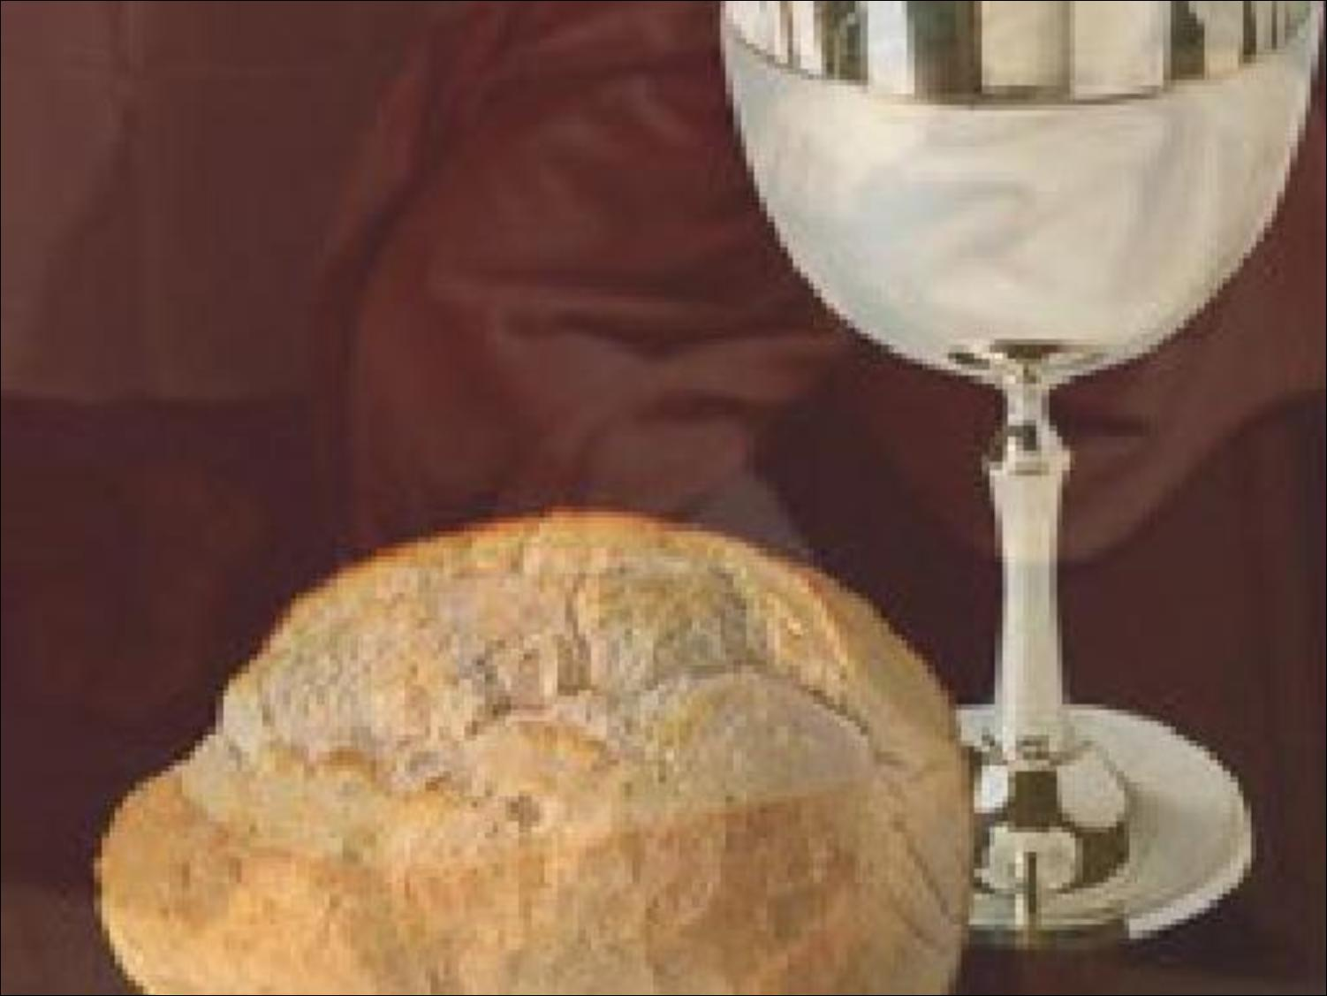
Holy
Communion

Slide 45
10,000 Reasons
( Bless the Lord )

Slide 46
Bless the Lord O my soul
O my soul
Worship His holy name
Sing like never before
O my soul
I’ll worship Your holy name.

Slide 47
The sun comes up it’s a new day dawning
It’s time to sing your song again
Whatever may pass and whatever lies before me
Let me be singing when the evening comes

Slide 48
Bless the Lord O my soul
O my soul
Worship His holy name
Sing like never before
O my soul
I’ll worship Your holy name.

Slide 49
You’re rich in love and You’re slow to anger
Your name is great and Your heart is kind
For all Your goodness I will keep on singing
Ten thousand reasons for my heart to find

Slide 50
Bless the Lord O my soul
O my soul
Worship His holy name
Sing like never before
O my soul
I’ll worship Your holy name.

Slide 51
And on that day when my strength is failing
The end draws near and my time has come
Still my soul will sing Your praise unending
Ten thousand years and then forever more

Slide 52
Bless the Lord O my soul
O my soul
Worship His holy name
Sing like never before
O my soul
I’ll worship Your holy name.

Slide 53
Worship Your holy name
Lord I’ll worship Your holy name.

Slide 55

THE PASTORAL BENEDICTION
God has a plan for you and,
you are EXACTLY where God wants you to be.

