Slide 1


Slide 2
To all who are spiritually weary and seek rest; to all who are sad and long for comfort; to all who struggle and desire victory; to all who sin and need a Savior; to all who are strangers and want friendship; to all who hunger and thirst for something real and lasting; and to all who come here, this church opens wide her doors and offers welcome in the name of the Lord Jesus Christ

Slide 3
Offsite contributions can be made via Tithely.com the instructions are on our website bayshoregardenscommunitychurch.com or checks can be mailed to
6228 26th street west
Bradenton FL 34207

Slide 4

Please Silence Cell Phones At This Time

Slide 6
It Is Well With My Soul
Hymn # 705

Slide 7
When peace like a river attendeth my way;
When sorrows like seabillows roll;
Whatever my lot, thou hast taught me to say;
“it is well, it is well with my soul”

Slide 8
It is well (it is well) with my soul (with my soul);
It is well, it is well with my soul

Slide 9
Though Satan should buffet, tho’ trials should come;
Let this blest assurance control;
That Christ has regarded my helpless estate;
And hath shed His own blood for my soul;

Slide 10
It is well (it is well) with my soul (with my soul);
It is well, it is well with my soul

Slide 11
My sin O, the bliss of this glorious thought;
My sin not in part but the whole;
Is nailed to the cross and I bear it no more;
Praise the Lord, praise the Lord, O my soul;

Slide 12
It is well (it is well) with my soul (with my soul);
It is well, it is well with my soul

Slide 13
And Lord, haste the day when the faith shall be sight;
The clouds be rolled back as a scroll;
The trump shall resound and the Lord shall descend;
Even so it is well with my soul;

Slide 14
It is well (it is well) with my soul (with my soul);
It is well, it is well with my soul

Slide 16
Welcome

Slide 17
Call To
Worship

Slide 18
Liturgist:
We are here to remember the love of God.

Slide 19
People:
We are here to remember the Last Supper of our Lord.

Slide 20
Liturgist:
Let us worship God in truth.

Slide 21
People:
We worship God with humility and devotion.

Slide 22
Liturgist:
Come, let us fix our eyes on Jesus, the founder and perfecter of our faith, who for the joy that was set before Him endured the cross, despising the shame, and is seated at the right hand of the throne of God.
(Hebrews 12.2)

Slide 23
People:
For in Him all the fullness of God was pleased to dwell, and through Him to reconcile to Himself all things, whether on earth or in heaven, making peace by the blood of His cross. (Colossians 1.19-20)

Slide 25
I Surrender All
Hymn # 596

Slide 26
All to Jesus I surrender,
All to Him I freely give;
I will ever love and trust Him,
In His presence daily live.

Slide 27
I surrender all
I surrender all
All to Thee my blessed Savior
I surrender all.

Slide 28
All to Jesus I surrender,
Humbly at His feet I bow;
Worldly pleasures all forsaken,
Take me Jesus, take me now

Slide 29
I surrender all
I surrender all
All to Thee my blessed Savior
I surrender all.

Slide 30
All to Jesus I surrender
Make me Savior, wholly Thine;
May Thy Holy Spirit fill me,
May I know Thy pow’r divine.

Slide 31
I surrender all
I surrender all
All to Thee my blessed Savior
I surrender all.

Slide 32
All to Jesus I surrender,
Lord I give myself to Thee
Fill me with Thy love and power,
Let Thy blessing fall on me.

Slide 33
I surrender all
I surrender all
All to Thee my blessed Savior
I surrender all.

Slide 34
A Moment for Silent Confession

Slide 35
Words of Assurance and Pardon of the Gospel

Slide 36
Hear what comforting words the Lord says to all who repent and come to Him: “Come to Me, all who are weary and heavy laden, and I will give you rest.”

Slide 37
This is a true statement and worthy of full acceptance: Christ Jesus came into the world to save sinners. If we confess our sins, He is faithful and just to forgive our sins and to cleanse us from all unrighteousness.

Slide 39
The Lord’s Prayer
OUR FATHER, WHO ART IN HEAVEN,
HALLOWED BE THY NAME.
THY KINGDOM COME, THY WILL BE DONE,
ON EARTH AS IT IS IN HEAVEN.
GIVE US THIS DAY OUR DAILY BREAD,
AND FORGIVE US OUR DEBTS AS WE FORGIVE OUR DEBTORS;
AND LEAD US NOT INTO TEMPTATION
BUT DELIVER US FROM EVIL.
FOR THINE IS THE KINGDOM,
AND THE POWER, AND THE GLORY FOREVER

Slide 40
Apostles’ Creed

Slide 41
I believe in God the Father, Almighty, Maker of heaven and earth; And in Jesus Christ, his only Son, our Lord; who was conceived by the Holy Ghost, born of the virgin Mary; suffered under Pontius Pilate; was crucified, dead, and buried.

Slide 42
He descended into hell; the third day He rose again from the dead; He ascended into heaven, and sitteth on the right hand of God the Father Almighty; from thence he shall come to judge the quick and the dead.

Slide 43
I believe in the Holy Ghost; the holy catholic church; the communion of saints; the forgiveness of sins; the resurrection of the body; and the life everlasting. Amen.

Slide 44
How Great Thou Art

Slide 45
O Lord my God, when I in awesome wonder
Consider all the worlds
Thy hands have made,
I see the stars,
I hear the rolling thunder,
Thy pow’r thro’out the universe displayed

Slide 46
Then sings my soul, my Savior God, to Thee;
How great Thou art, how great Thou art!
Then sings my soul, my Savior God to Thee:
How great Thou art, how great Thou art!

Slide 47
When thro’ the woods and forest glades I wander
And hear the birds sing sweetly in the trees,
When I look down from lofty mountain grandeur,
And hear the brook and feel the gentle breeze.

Slide 48
Then sings my soul, my Savior God, to Thee;
How great Thou art, how great Thou art!
Then sings my soul, my Savior God to Thee:
How great Thou art, how great Thou art!

Slide 49
And when I think that God,
His Son not sparing,
Sent Him to die,
I scarce can take it in,
That on the cross, my burden gladly bearing,
He bled and died to take away my sin.

Slide 50
Then sings my soul, my Savior God, to Thee;
How great Thou art, how great Thou art!
Then sings my soul, my Savior God to Thee:
How great Thou art, how great Thou art!

Slide 51
When Christ shall come with shout of acclamation
And take me home, what joy shall fill my heart!
Then I shall bow in humble adoration,
And there proclaim, my God, how great Thou art.

Slide 52
Then sings my soul, my Savior God, to Thee;
How great Thou art, how great Thou art!
Then sings my soul, my Savior God to Thee:
How great Thou art, how great Thou art!

Slide 54
SCRIPTURE READING:
Matthew 27:11-26

Slide 55
MEDITATION:
“It Should Have Been Me”
Rev. Dustin Sedlak

Slide 56
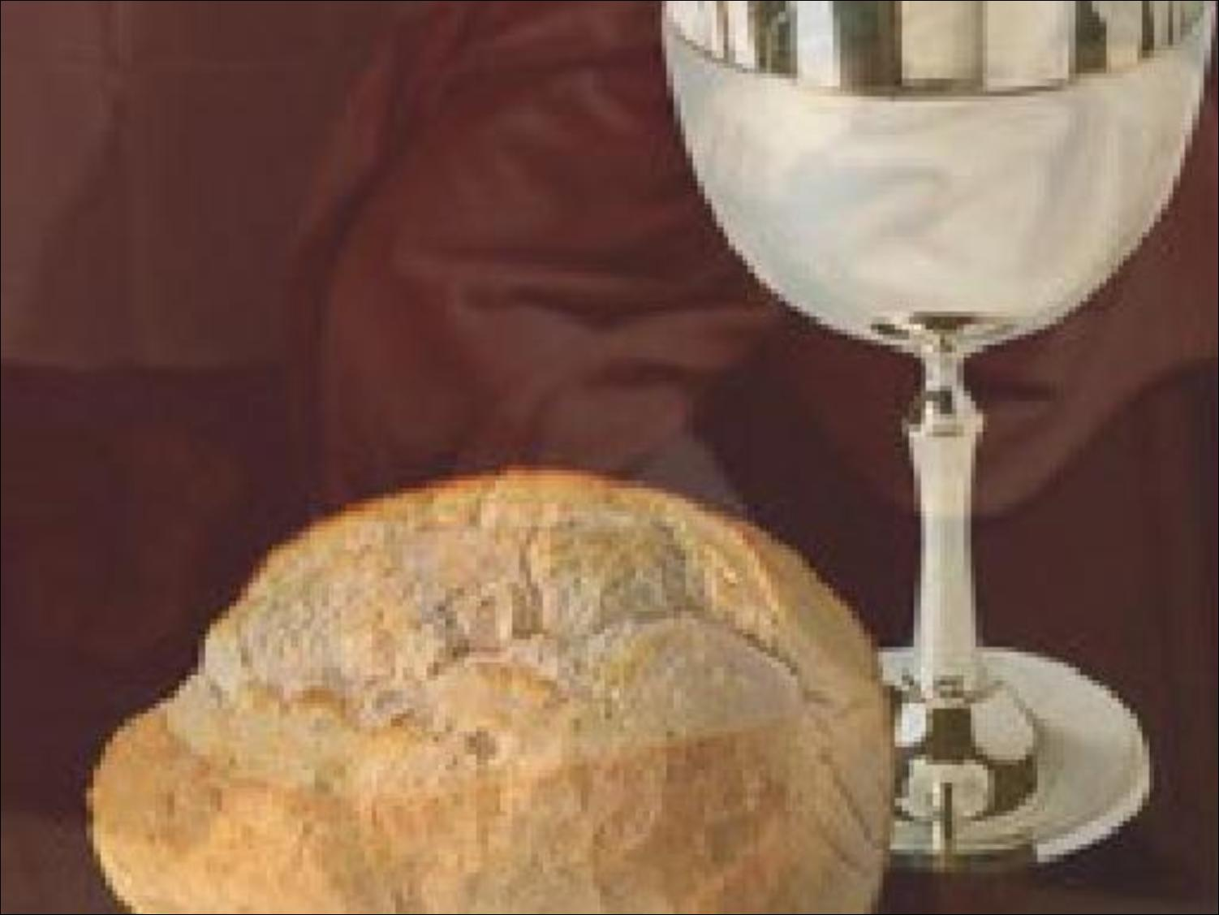
Holy
Communion

Slide 57
The Old Rugged Cross hymn # 327

Slide 58
On a hill far away stood an old rugged cross, the emblem of suff’ring and shame
And I love that old cross, where the dearest and best
For a world of lost sinners was slain

Slide 59
So I’ll cherish the old rugged cross,
Till my trophies at last I lay down.
I will cling to the old rugged cross, and exchange it someday for a crown

Slide 60
O the old rugged cross, so despised by the world,
Has a wondrous attraction for me;
For the dear Lamb of God left His glory above to bear it to dark Calvary

Slide 61
So I’ll cherish the old rugged cross,
Till my trophies at last I lay down.
I will cling to the old rugged cross, and exchange it someday for a crown

Slide 62
In the old rugged cross, stained with blood so divine, a wondrous beauty I see;
For ‘twas on that old cross Jesus suffered and died
To pardon and sanctify me

Slide 63
So I’ll cherish the old rugged cross,
Till my trophies at last I lay down.
I will cling to the old rugged cross, and exchange it someday for a crown

Slide 64
To the old rugged cross
I will ever be true
It’s shame and reproach gladly bear.
Then He’ll call me someday to my home faraway where His glory forever I’ll share.

Slide 65
So I’ll cherish the old rugged cross,
Till my trophies at last I lay down.
I will cling to the old rugged cross, and exchange it someday for a crown

Slide 67
THE PASTORAL BENEDICTION
“You go nowhere by accident.
Wherever you go, God is sending you.
Wherever you are, God has put you there.
He has purpose in putting you there.
Christ who dwells in you has something He wants to do through you wherever you are. Believe this and go in His grace and love and power.”
-Dick Halverson, former Chaplain of the US Congress

Slide 69
Offsite contributions can be made via Tithely.com the instructions are on our website bayshoregardenscommunitychurch.com or checks can be mailed to
6228 26th street west
Bradenton FL 34207

