Slide 2
To all who are spiritually weary and seek rest; to all who are sad and long for comfort; to all who struggle and desire victory; to all who sin and need a Savior; to all who are strangers and want friendship; to all who hunger and thirst for something real and lasting; and to all who come here, this church opens wide her doors and offers welcome in the name of the Lord Jesus Christ

Slide 3
Please Silence Cell Phones At This Time

Slide 5
The Solid Rock Hymn # 526

Slide 6
My hope is built on nothing less Than Jesus’ blood and righteousness; I dare not trust the sweetest frame, But wholly lean on Jesus’ name. On Christ the solid Rock I stand; All other ground is sinking sand, All other ground is sinking sand.

Slide 7
When darkness veils His lovely face, I rest on His unchanging grace; In every high and stormy gale, My anchor holds within the veil. On Christ the solid Rock I stand; All other ground is sinking sand, All other ground is sinking sand.

Slide 8
His oath, His covenant, His blood Support me in the whelming flood; When all around my soul gives way He then is all my hope and stay. On Christ the solid Rock I stand; All other ground is sinking sand, All other ground is sinking sand.

Slide 9
When He shall come with trumpet sound, O may I then in Him be found; Dressed in His righteousness alone, Faultless to stand before the throne On Christ the solid Rock I stand; All other ground is sinking sand, All other ground is sinking sand.

Slide 11
WELCOME

Slide 12
Lighting of the Advent Candles

Slide 13
Call To Worship Elder Roy Palk Liturgist

Slide 14
Reader: We come from a world of darkness

Slide 15
People: Into Christ’s world of light.

Slide 16
Reader: We come from a world of weariness

Slide 17
People: Into God’s strength and hope.

Slide 18
Reader: We come from a distracted world.

Slide 19
People: Strengthened by God’s Holy Spirit, we come to awaken our souls and watch for the coming of Christ.

Slide 21
Come,Thou Long Expected Jesus
Hymn 244

Slide 22
Come, Thou long expected Jesus,
Born to set Thy people free;
From our fears and sins release us;
Let us find our rest in Thee.
Israel’s strength and consolation;
Hope of all the earth Thou art;
Dear Desire of every nation,
Joy of every longing heart.

Slide 23
Born Thy people to deliver,
Born a child and yet a king.
Born to reign in us forever,
Now Thy gracious kingdom bring.
By Thine own eternal Spirit
Rule in all our hearts alone;
By Thine all sufficient merit,
Raise us to Thy glorious throne.
*

Slide 25
Come,Thou Long Expected Jesus
Hymn 244

Slide 26
Come, Thou long expected Jesus,
Born to set Thy people free;
From our fears and sins release us;
Let us find our rest in Thee.
Israel’s strength and consolation;
Hope of all the earth Thou art;
Dear Desire of every nation,
Joy of every longing heart.

Slide 27
Born Thy people to deliver,
Born a child and yet a king.
Born to reign in us forever,
Now Thy gracious kingdom bring.
By Thine own eternal Spirit
Rule in all our hearts alone;
By Thine all sufficient merit,
Raise us to Thy glorious throne.
*

Slide 29
Prayer of confession

Slide 30
Reader: O Lord Christ, we confess our willingness to be loved

Slide 31
People: but also confess our reluctance to love others.

Slide 32
Reader: We confess our readiness to accept Your forgiving love,

Slide 33
People: but also our refusal to forgive others.

Slide 34
Reader: We confess our eagerness to grasp Your offer of redeeming love,

Slide 35
People: but also our resistance to follow You without question.

Slide 36
Reader: In this Advent time, forgive us our failure to act and live as we should. Come to us anew, and by Your grace, assist us to receive You with joy, with gratitude, with obedience, with love, as You have loved us.

Slide 37
People: Even so: come, Lord Jesus. Lord, hear our prayers.

Slide 39
A Moment for Silent Confession

Slide 40
Words of Assurance and Pardon of the Gospel Jeanie Smith, Liturgist

Slide 41
Reader: The people who walked in darkness have seen a great light; those who dwelt in a land of deep darkness, on them has light shone. (Isaiah 9.2)

Slide 43
O Come, O come Emmanuel

Slide 44
O come, O come Emmanuel, And ransom captive Israel That mourns in lowly exile here, Until the son of God appear.

Slide 45
Rejoice! Rejoice! Emmanuel shall come to you, O Israel.

Slide 46
O come, Thou Dayspring, come and cheer Our spirits by Thine advent here; Disperse the gloomy clouds of night, And death’s dark shadows put to flight.

Slide 47
Rejoice! Rejoice! Emmanuel shall come to you, O Israel.

Slide 48
O come, Thou Wisdom from on high And order all things far and nigh; To us the path of knowledge show and cause us in her ways to go.

Slide 49
Rejoice! Rejoice! Emmanuel shall come to you, O Israel.

Slide 50
O come, Desire of nations, bind All peoples in one heart and mind; Bid envy, strife and quarrels cease; Fill the whole world with heaven’s peace.

Slide 51
Rejoice! Rejoice! Emmanuel shall come to you, O Israel.

Slide 52
Teaching Moment “It’s (Almost) Here.” Pastor Dustin

Slide 53
The Lord’s Prayer
OUR FATHER, WHO ART IN HEAVEN,
HALLOWED BE THY NAME.
THY KINGDOM COME, THY WILL BE DONE,
ON EARTH AS IT IS IN HEAVEN.
GIVE US THIS DAY OUR DAILY BREAD,
AND FORGIVE US OUR DEBTS AS WE FORGIVE OUR DEBTORS;
AND LEAD US NOT INTO TEMPTATION
BUT DELIVER US FROM EVIL.
FOR THINE IS THE KINGDOM,
AND THE POWER, AND THE GLORY FOREVER
AMEN

Slide 54
OFFERTORY

Slide 55
Offsite contributions can be made via Tithely.com the instructions are on our website bayshoregardenscommunitychurch.com or checks can be mailed to 6228 26th street west Bradenton FL 34207

Slide 56
Offering Song: “As the Deer” arrangement by Ken Gallo

Slide 57
Holy Communion

Slide 58
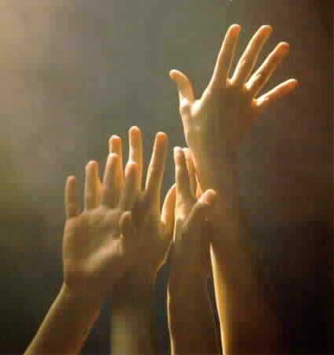
‘O COME, ALL YE FAITHFUL’
#249
[ All who are able please stand ]

Slide 59
(1)
O come all ye faithful,
joyful and triumphant,
O come ye, O come ye to Bethlehem!
Come and behold Him,
born the King of angels.
O come, let us adore Him,
O come, let us adore Him,
O come, let us adore Him,
Christ, the Lord.

Slide 60
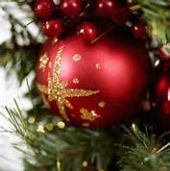
(2)
Sing, choirs of angels,
sing in exultation;
O sing all ye bright hosts of heaven above!
Glory to God,
all glory in the highest.
O come, let us adore Him,
O come, let us adore Him,
O come, let us adore Him,
Christ, the Lord.

Slide 61
(3)
Yea, Lord, we greet Thee,
born this happy morning;
Jesus, to You be all glory given;
Word of the Father
now in flesh appearing!
O come, let us adore Him,
O come, let us adore Him,
O come, let us adore Him,
Christ, the Lord.

Slide 63
THE PASTORAL BENEDICTION
God has a plan for you and,
you are EXACTLY where God wants you to be.

