Slide 2
To all who are spiritually weary and seek rest; to all who are sad and long for comfort; to all who struggle and desire victory; to all who sin and need a Savior; to all who are strangers and want friendship; to all who hunger and thirst for something real and lasting; and to all who come here, this church opens wide her doors and offers welcome in the name of the Lord Jesus Christ

Slide 3
Please Silence Cell Phones At This Time

Slide 5
Amazing Grace Hymn # 343

Slide 6
Amazing grace How sweet the sound That saved a wretch like me I once was lost, But now am found Was blind, but now I see

Slide 7
‘Twas grace that taught My heart to fear, And grace my fears relieved; How precious did That grace appear The hour I first believed

Slide 8
The Lord has promised good to me; His Word my hope secures. He will my shield and portion be As long as life endures

Slide 9
Through many dangers, Toils and snares, I have already come; ‘Tis grace hath brought me safe thus far, And grace will lead me home

Slide 10
When we’ve been there Ten thousand years Bright shining as the sun We’ve no less days to sing God’s praise Than when we’d first begun

Slide 12
Peace Like A River Hymn # 750

Slide 13
I’ve got peace like a river, I’ve got peace like a river, I’ve got peace like a river in my soul

Slide 14
I’ve got peace like a river, I’ve got peace like a river, I’ve got peace like a river in my soul

Slide 15
I’ve got love like an ocean, I’ve got love like an ocean, I’ve got love like an ocean in my soul.

Slide 16
I’ve got love like an ocean, I’ve got love like an ocean, I’ve got love like an ocean in my soul.

Slide 17
I’ve got joy like a fountain, I’ve got joy like a fountain, I’ve got joy like a fountain in my soul

Slide 18
I’ve got joy like a fountain, I’ve got joy like a fountain, I’ve got joy like a fountain in my soul

Slide 20
WELCOME

Slide 21
Angels from the Realms of Glory Hymn # 259

Slide 22
Angels from the realms of glory, Wing your flight o’er all the earth; Ye who sang creation’s story, Now proclaim Messiah’s birth: Come and worship, come and worship, Worship Christ , the newborn King.

Slide 23
Shepherds in the fields abiding, Watching o’er your flocks by night, God with man is now residing, Yonder shines the infant Light: Come and worship, come and worship, Worship Christ , the newborn King.

Slide 24
Sages, leave your contemplations, Brighter visions beam afar; Seek the great Desire of nations, Ye have seen his natal star: Come and worship, come and worship, Worship Christ , the newborn King.

Slide 25
Saints before the altar bending, Watching long in hope and fear, Suddenly the Lord, descending, In his temple shall appear: Come and worship, come and worship, Worship Christ , the newborn King.

Slide 26
Tho’ an infant now we view Him, He will share His Father’s throne; Gather all the nations to Him; Every knee shall then bow down. Come and worship, come and worship Worship Christ the new born king

Slide 28
Reading and Lighting of Advent Candle: Ken and Dianne Gallo

Slide 30
Christmas Prayer for Illumination: Dee Frank, Liturgist

Slide 31
ALL: Dear Heavenly Father, Help me to hear your voice. Send Us your Holy Spirit once again. Give me the courage to be your beloved. Give me courage to choose joy. I need you now this Christmas. Be born in me again. Today. In Jesus' name, Amen.

Slide 32
Angels We Have Heard on High
Hymn 113

Slide 33
Angels we have heard on high,
Sweetly singing o’er the plains,
And the mountains in reply
Echo back their joyous strains.
Gloria in excelsis Deo,
Gloria in excelsis Deo.

Slide 34
Shepherds, why this jubilee?
Why your joyous strains prolong?
Say what may the tidings be,
Which inspire your heav’nly song?
Gloria in excelsis Deo,
Gloria in excelsis Deo.
verse 2 & refrain

Slide 35
Come to Bethlehem, and see
Him whose birth the angels sing;
Come, adore on bended knee
Christ the Lord, the newborn King.
Gloria in excelsis Deo,
Gloria in excelsis Deo.
verse 3 & refrain

Slide 36
See within a manger laid
Jesus, Lord of heav’n and earth!
Mary, Joseph, lend your aid,
With us sing our savior’s birth.
Gloria in excelsis Deo,
Gloria in excelsis Deo.
* verse 4 & refrain

Slide 38
Teaching Moment Pastor Dustin Advent Teaching Series

Slide 39
The Lord’s Prayer
OUR FATHER, WHO ART IN HEAVEN,
HALLOWED BE THY NAME.
THY KINGDOM COME, THY WILL BE DONE,
ON EARTH AS IT IS IN HEAVEN.
GIVE US THIS DAY OUR DAILY BREAD,
AND FORGIVE US OUR DEBTS AS WE FORGIVE OUR DEBTORS;
AND LEAD US NOT INTO TEMPTATION
BUT DELIVER US FROM EVIL.
FOR THINE IS THE KINGDOM,
AND THE POWER, AND THE GLORY FOREVER
AMEN

Slide 40
OFFERTORY

Slide 41
Offsite contributions can be made via Tithely.com the instructions are on our website bayshoregardenscommunitychurch.com or checks can be mailed to 6228 26th street west Bradenton FL 34207

Slide 42
Offering Song: “Emmanuel” arrangement by Ken Gallo

Slide 43
Doxology

Slide 44
Praise God
from whom all blessings flow;
Praise Him,
all creatures here below;
Praise Him
above, ye heav’nly host;
Praise Father,
Son, and Holy Ghost.

Slide 46
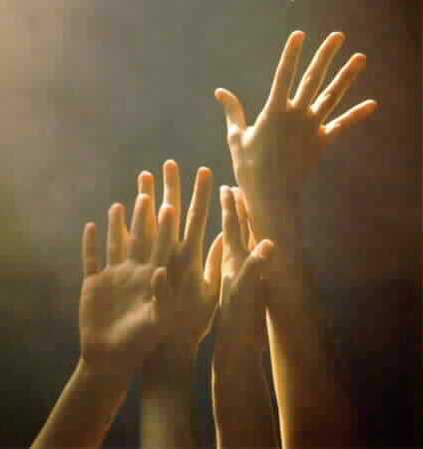
‘O COME, ALL YE FAITHFUL’
#249
[ All who are able please stand ]

Slide 47
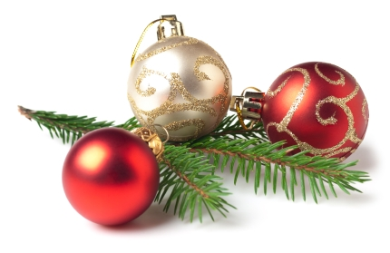
(1)
O come all ye faithful,
joyful and triumphant,
O come ye, O come ye to Bethlehem!
Come and behold Him,
born the King of angels.
O come, let us adore Him,
O come, let us adore Him,
O come, let us adore Him,
Christ, the Lord.

Slide 48
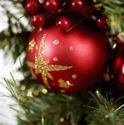
(2)
Sing, choirs of angels,
sing in exultation;
O sing all ye bright hosts of heaven above!
Glory to God,
all glory in the highest.
O come, let us adore Him,
O come, let us adore Him,
O come, let us adore Him,
Christ, the Lord.

Slide 49
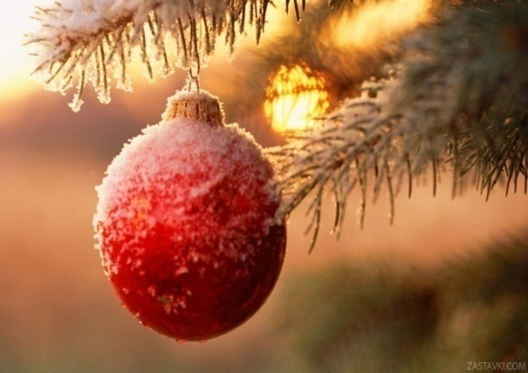
(3)
Yea, Lord, we greet Thee,
born this happy morning;
Jesus, to You be all glory given;
Word of the Father
now in flesh appearing!
O come, let us adore Him,
O come, let us adore Him,
O come, let us adore Him,
Christ, the Lord.

Slide 52
THE PASTORAL BENEDICTION
God has a plan for you and,
you are EXACTLY where God wants you to be.

